Slide 1
Simulating Omitted Confounders in Structural Equation Modeling: Sensitivity Analysis with Brute Force Search Algorithm
Huan “Hailey” Kuang, Zeyuan Jing, Walter L. Leite
University of Florida
American Educational Research Association 2021 Virtual Annual Meeting
April 11, 2021

Slide 2
Outline
1. Introduction
2. Method
4. Result
5. Discussion
3. Example

Slide 3
Introduction

Slide 4
Introduction
Empirical studies may not perfectly measure all confounders due to cost, ethical issues, and other considerations.
Omitting confounders from structural equation modeling (SEM) is one of the major but overlooked problems in misspecification literature (Kaplan, 1990).
Omitted confounders could introduce bias and lead to a completely different interpretation and inference (VanderWeele & Arah, 2011; De Stavola, et.al, 2014; Sullivan, 2015).
Several sensitivity analysis techniques have been developed to evaluate the impact of unmeasured confounders in the causal inference literature. However, the existed techniques were mainly focused on observed variables and designed for a binary unmeasured confounder (e.g., Rosenbaum & Rubin, 1983; Lindmark, Luna, & Eriksson, 2018).
This study proposes an approach for examining the extent to which structural equation models are robust to unmeasured confounders.

Slide 5
Method

Slide 6
Method
Brute Force Search: enumerated all possible omitted confounders.
The possible omitted confounders were simulated through the correlation between this confounder and all measured variables.
And then, we check whether each simulated confounder alters the conclusions of proposed SEM model.
p-values of the path coefficients change from significant to non-significant
The positive path coefficients become to negative
The path coefficients becoming zero

Slide 7
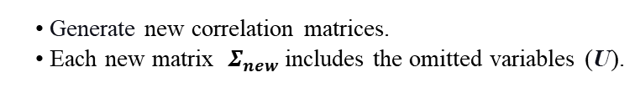
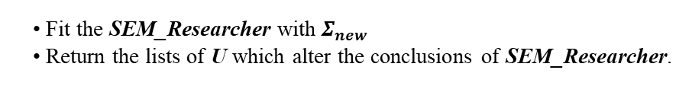
Propose and fit a SEM model: SEM_Researcher
STEP 1
Calculate correlation matrix Σ = 𝐶𝑜𝑣 (𝑋).
where X are the observed variables.
STEP 2
Researcher
Generate new correlation matrices.
Each new matrix ${ Σ}_{new}$includes the omitted variables (U).
Brute Force Search Algorithm
STEP 3
Fit the SEM_Researcher with${ Σ}_{new}$
Return the lists of U which alter the conclusions of SEM_Researcher.
STEP 4
Make the decision about whether the simulated U exists or not.
STEP 5

Slide 8
Example

Slide 9
Example
We demonstrate the Brute Force Search Algorithm by analyzing an empirical dataset from Jen, et.al, (2013).
Science achievement was derived from 2007 Trends in International Mathematics and Science Study (TIMSS).
Teacher-student relationship, peer relationship, positive attitudes toward science, and self-confidence in learning science were collected from a TIMSS based follow-up national survey.
The dataset contains 3,901 grade 8 students.

Slide 10
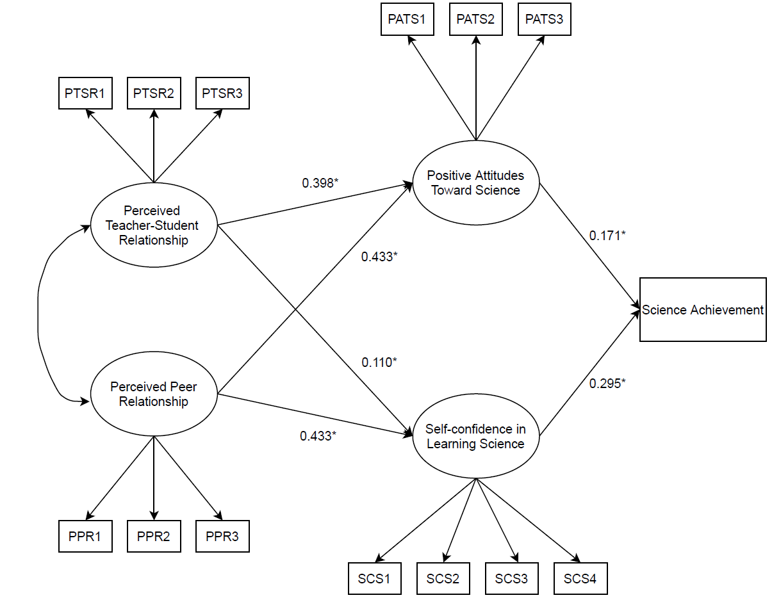
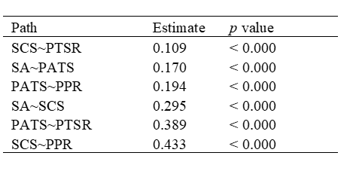
Table 1: Summary for the paths
0.194*
Figure 1. SEM_Researcher: The social-relation-based affection-driven model

Slide 11
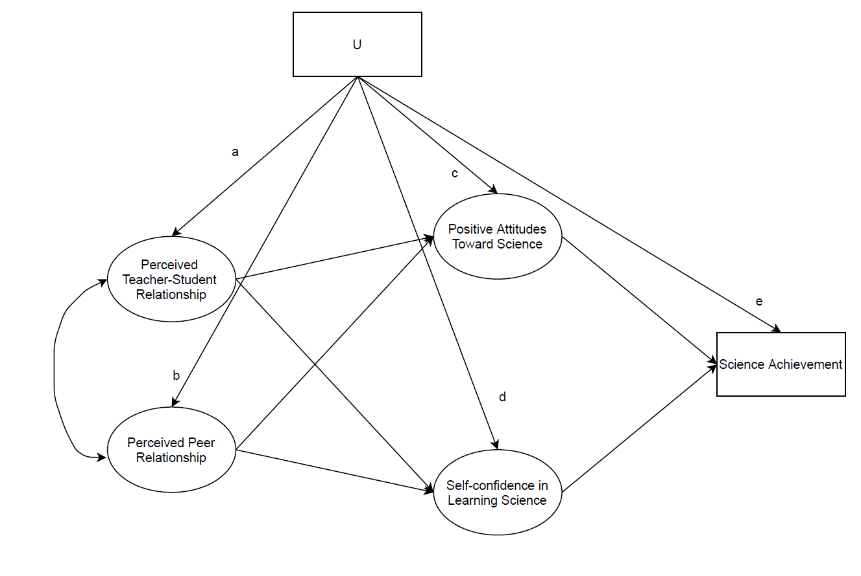
Figure 2. The model with omitted confounder U

Slide 12
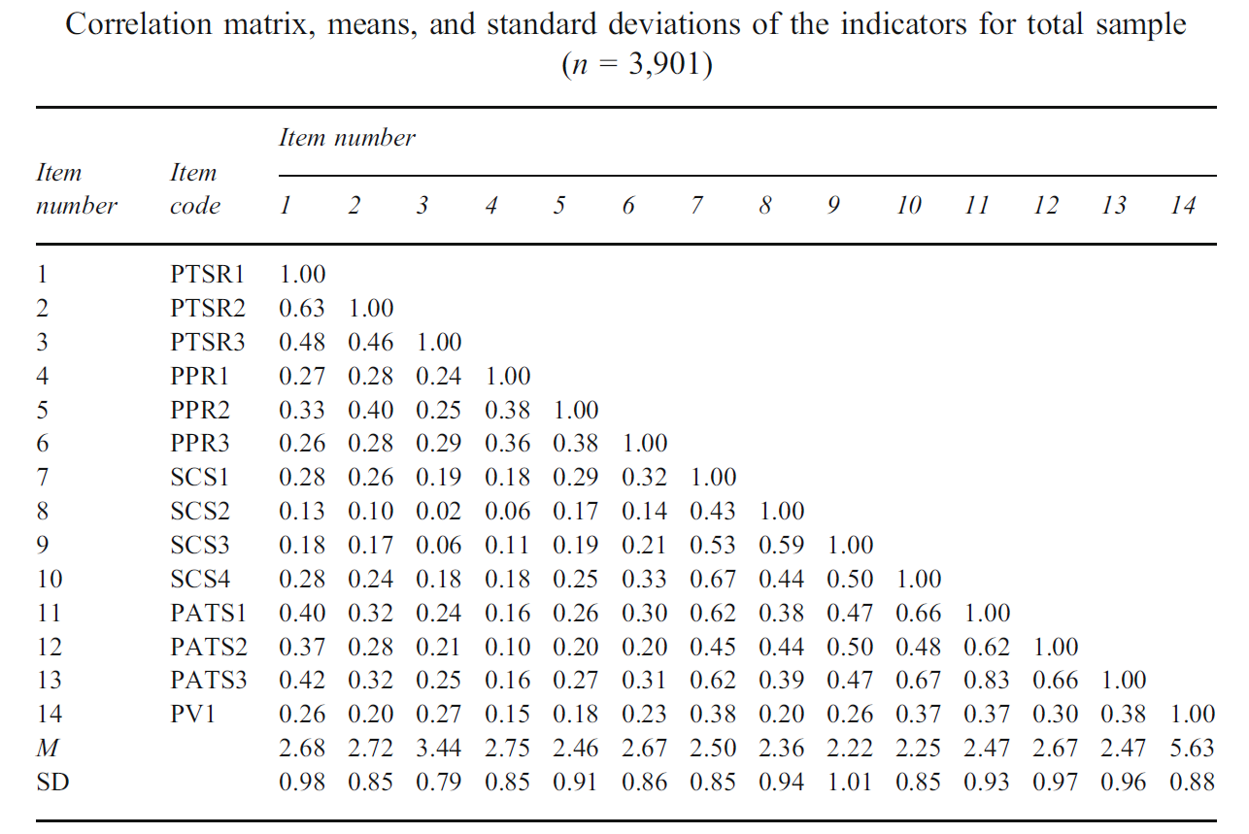
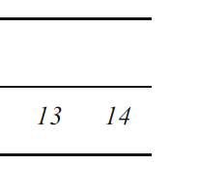
Table 2: an example of${ Σ}_{new}$
We simulated
161, 051 confounders based on the correlations (a, b, c, d, and e) by looping over 11 values (0, 0.1, 0.2, … , 1.0).
13, 943 confounders
are valid in terms of generating the positive definite matrix.
15
15 U 0.10 0.10 0.10 0.20 0.20 0.20 0.40 0.40 0.40 0.40 0.10 0.10 0.10 0.50 1.00
a = 0.10 b = 0.20 c = 0.40 d = 0.10 e = 0.50

Slide 13
Result

Slide 14
Table 2: Summary for sensitivity analysis with Brute Force Search Algorithm
Among the six paths:
the one from
“positive attitudes toward science” to “science achievement” is the most robust.
the one from
“peer relationship” to “positive attitudes toward science” is the least robust.

Slide 15
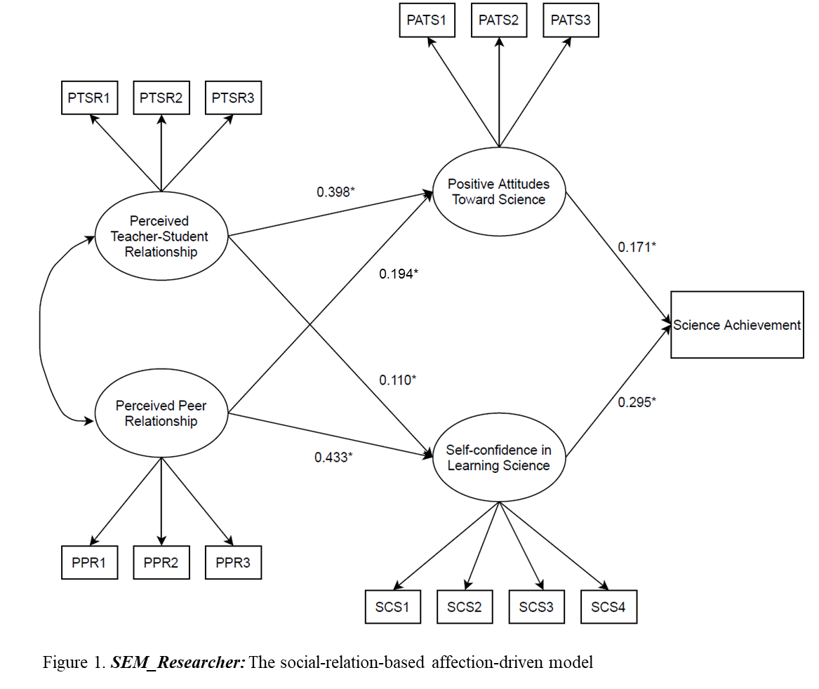
Example:
The path from Peer Relationship
to Positive Attitudes Toward Science

Slide 16
Result 1: p-value change
Table 3: the simulated confounders U that cause the p-valu$e^{1}$ change for the example path
There are 984 combinations of a, b, c, d, and e changed the p value of the example path from significant to non-significant. We listed 10 of them in this table.
The combination with smaller correlation values is less robust, because the chance that a confounder has smaller correlation values with the measured variables are larger.
Note. ¹ percentage of the estimated path coefficients change from significance to non-significance.
Example: the path from Peer Relationship to Positive Attitudes Toward Science
Notes:
It is hard for researchers to go through all 984 combinations, so we further classify the 984 combinations by matching with a value and k-means.

Slide 17
Follow-up analysis 1: matching sensitivity parameter with a value
This requires to have a hypothesis about the correlation between omitted confounders and the measured variable.
For example, a = 0.1, b = NULL, c = 0.3, d = NULL, e = 0.4, Type = p value.
There is only one combination meet the matching criteria.
The researchers need to determine whether this specific U exists or not.
Table 4: the simulated confounders U that cause the p-valu$e^{1}$ change for the example path base on the matching criteria

Slide 18
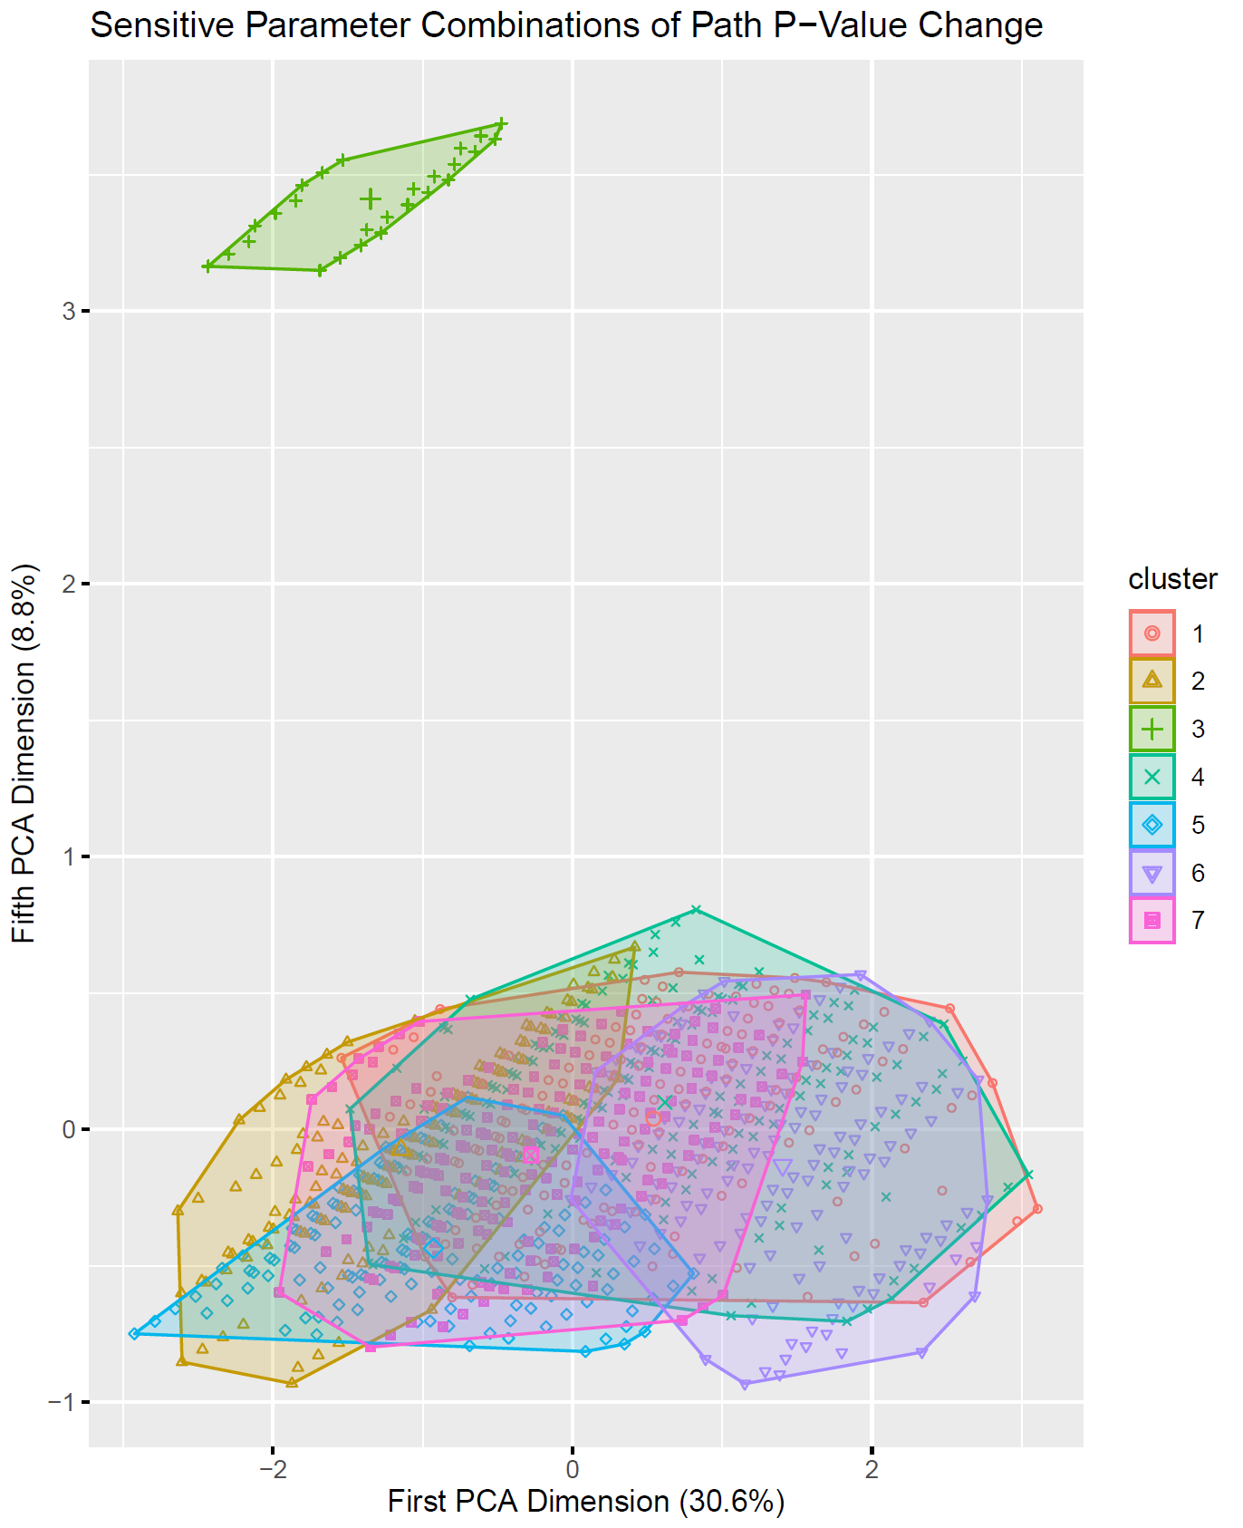
Follow-up analysis 2: k-means
Table 5: Cluster Centers of each Cluster from K-Means
 | a | b | c | d | e | Size
Cluster1 | 0.440 | 0.456 | 0.378 | 0.505 | 0.522 | 156
Cluster2 | 0.135 | 0.485 | 0.355 | 0.279 | 0.181 | 150
Cluster3 | 0.600 | 0.035 | 0.127 | 0.065 | 0.146 | 26
Cluster4 | 0.114 | 0.325 | 0.363 | 0.429 | 0.615 | 177
Cluster5 | 0.130 | 0.348 | 0.090 | 0.406 | 0.232 | 149
Cluster6 | 0.190 | 0.261 | 0.489 | 0.593 | 0.218 | 144
Cluster7 | 0.473 | 0.487 | 0.350 | 0.476 | 0.142 | 182
We conducted K-means based on the combination of the sensitive parameters (correlation a, b, c, d, e).
Projected the results onto the PCA coordinates to visualize the cluster differences. Each dimension contains information from the combination of the sensitive parameter.
Cluster 3 is substantially different from the other clusters on the fifth dimension.

Slide 19
Result 2: direction change
There are 2056 combinations of a, b, c, d, and e changed the path coefficients from positive to negative. We listed 10 of them in this table.
The combination with smaller correlation values is less robust, because the chance that a confounder has smaller correlation values with the measured variables are larger.
Table 6: the simulated confounders U that cause the directio$n^{1}$ change for the example path
Note. ¹ percentage of the estimated path coefficients change from positive to negative.
Example: the path from Peer Relationship to Positive Attitudes Toward Science

Slide 20
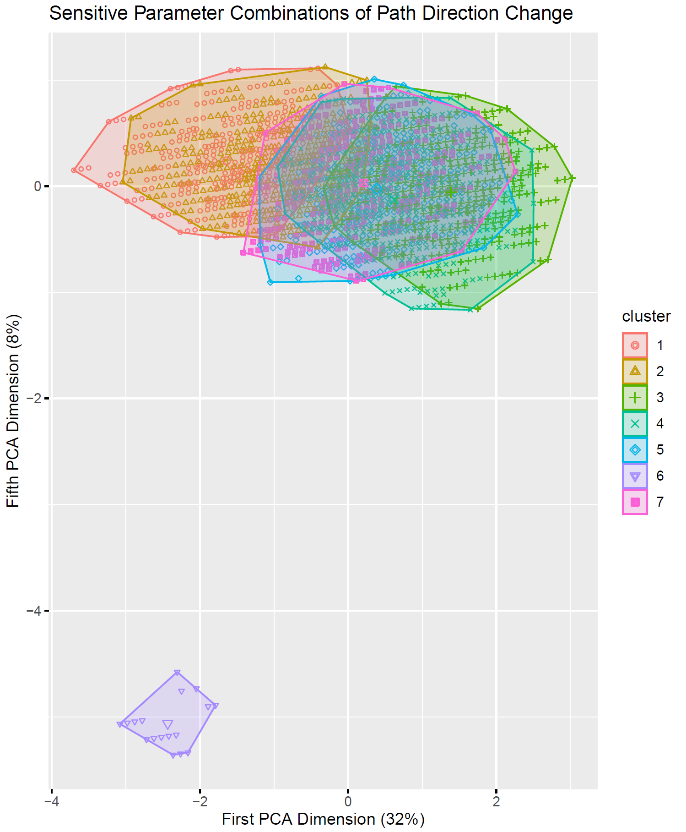
Follow-up analysis: k-means
Table 7: Cluster Centers of each Cluster from K-Means
 | a | b | c | d | e | Size
Cluster1 | 0.100 | 0.421 | 0.178 | 0.426 | 0.097 | 303
Cluster2 | 0.107 | 0.419 | 0.206 | 0.432 | 0.422 | 327
Cluster3 | 0.400 | 0.445 | 0.468 | 0.614 | 0.471 | 363
Cluster4 | 0.447 | 0.466 | 0.358 | 0.580 | 0.149 | 321
Cluster5 | 0.115 | 0.345 | 0.448 | 0.536 | 0.579 | 353
Cluster6 | 0.600 | 0.000 | 0.100 | 0.029 | 0.147 | 17
Cluster7 | 0.123 | 0.348 | 0.470 | 0.568 | 0.158 | 372
Cluster 6 is substantially different from the other clusters on the fifth dimension.

Slide 21
Result 3: effect reduce
Table 8: the simulated confounders U that cause the effec$t^{1}$ reduce for the example path
There are 903 combinations of a, b, c, d, and e changed path coefficients close to zero. We listed 10 of them in this table.
The combination with smaller correlation values is less robust, because the chance that a confounder has smaller correlation values with the measured variables are larger.
Note. ¹ percentage of the estimated path coefficients change close to zero.
Example: the path from Peer Relationship to Positive Attitudes Toward Science

Slide 22
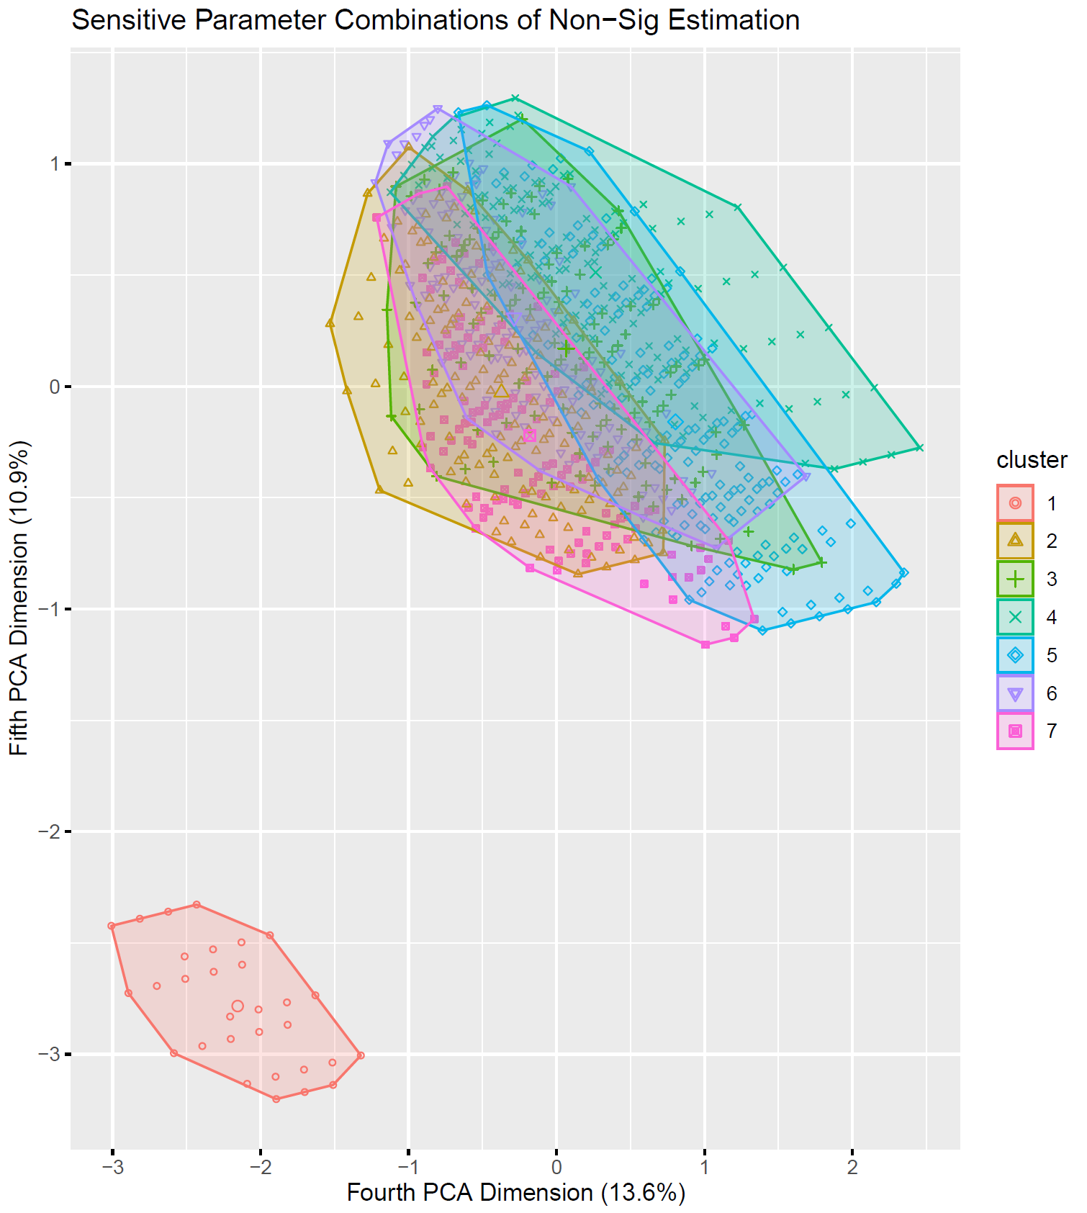
Follow-up analysis: k-means
Table 9: Cluster Centers of each Cluster from K-Means
 | a | b | c | d | e | Size
Cluster1 | 0.600 | 0.043 | 0.127 | 0.057 | 0.170 | 30
Cluster2 | 0.415 | 0.360 | 0.449 | 0.620 | 0.468 | 150
Cluster3 | 0.435 | 0.376 | 0.370 | 0.590 | 0.132 | 133
Cluster4 | 0.115 | 0.352 | 0.135 | 0.384 | 0.153 | 154
Cluster5 | 0.110 | 0.269 | 0.480 | 0.502 | 0.202 | 167
Cluster6 | 0.109 | 0.350 | 0.184 | 0.393 | 0.518 | 136
Cluster7 | 0.138 | 0.288 | 0.445 | 0.500 | 0.660 | 133
Cluster 1 is substantially different from the other clusters on the fourth and the fifth dimensions.

Slide 23
Discussion

Slide 24
Discussion
Comparing with other methods presented in this section, this sensitivity analysis with Brute Force Search Algorithm is able to examining multiple omitted variables at once.
However, to investigate the impact of an unmeasured variable in a more complicated model with this approach is a time-consuming task due to the exponential growth.
The fundamental principle of this study was encouraging the researchers to run this proposed sensitivity analysis as an additional verification step after running their SEM models. The study contributes to the discussion of sensitivity analyses beyond observed variables.
The proposed method is potentially useful for researchers to determine whether their conclusions would change if there are unmeasured confounders.

Slide 25
Reference
De Stavola, B. L., Daniel, R. M., Ploubidis, G. B., & Micali, N. (2014). Mediation analysis with intermediate confounding: structural equation modeling viewed through the causal inference lens. American journal of epidemiology, 181(1), 64-80.
Jen, T. H., Lee, C. D., Chien, C. L., Hsu, Y. S., & Chen, K. M. (2013). Perceived social relationships and science learning outcomes for Taiwanese eighth graders: Structural equation modeling with a complex sampling consideration. International Journal of Science and Mathematics Education, 11(3), 575-600.
Kaplan, D. (1990). Evaluating and modifying covariance structure models: A review and recommendation. Multivariate Behavioral Research, 25(2), 137-155.
Lindmark, A., de Luna, X., & Eriksson, M. (2018). Sensitivity analysis for unobserved confounding of direct and indirect effects using uncertainty intervals. Statistics in Medicine, 37, 1744–1762.
Muthén, B., & Asparouhov, T. (2015) Causal Effects in Mediation Modeling: An Introduction With Applications to Latent Variables, Structural Equation Modeling: A Multidisciplinary Journal, 22(1), 12-23.
Rosenbaum, P. R., & Rubin, D. B. (1983). Assessing sensitivity to an unobserved binary covariate in an observational study with binary outcome. Journal of the Royal Statistical Society. Series B (Methodological), 212-218.
Sullivan, A. J. (2015). Sensitivity analysis for linear structural equation models, longitudinal mediation with latent growth models and blended learning in biostatistics education. Ph.D. Dissertation. Harvard University.
VanderWeele, T. J., & Arah, O. A. (2011). Unmeasured confounding for general outcomes, treatments, and confounders: bias formulas for sensitivity analysis. Epidemiology (Cambridge, Mass.), 22(1), 42.

Slide 26

The end. Thank you!

